Slide 1
The Prophets

Slide 2
What is Prophesy?
It is NOT the ability to predict or “see” the future! Although because prophets often speak of general future consequences, it is often viewed this way in hindsight.
It is actually the ability to recognise the will of God, and convey this to others.

Slide 3
Types of Prophets
Guild prophets – are part of the system.
Spokespersons for the status quo
Gave ‘divine’ endorsement to the dominant social-political group
Did not ‘rock the boat’
Both prophet and priest are ungodly;
even in my house I have found their wickedness, (Jer 23-11)
But in the prophets of Jerusalem
I have seen a more shocking thing:
they commit adultery and walk in lies;
they strengthen the hands of evildoers,
so that no one turns from wickedness;
all of them have become like Sodom to me,
and its inhabitants like Gomorrah. (Jer 23:14)
Notes:
Guild Prophets – official prophets generally placated the leaders of the time.

Slide 4
Charismatic prophets
Were not crystal ball gazers predicting future events
Spoke for their own times and not for the distant future
Read the ‘signs of the times’
Warn of punishment in the immediate future where they see error and abuse
Are not solitary figures but represent concerns and points of view of different groups in their society
Notes:
Charismatic Prophets – speak out against the guild prophets for their exploitations.

Slide 5
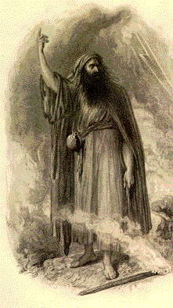
Prophets usually speak about:
Social justice;
The law (covenant) and the importance of obeying God;
Specific consequences in an individual’s life if they continue on a certain path (for example, the prophet Nathan and King David);
Idolatry and the worship of other gods.
They are social commentators, who speak about current events, problems, irregularities, and changes to religious life.

Slide 6
Prophets are
extraordinary preachers
came rarely - in times of religious crisis
preached dramatically on subjects of fundamental religious importance
motivated by the conviction of being called by God

Slide 7
A prophet
lives an honest, holy life
teaching agrees with Mosaic doctrine
is not afraid to challenge people of power and influence
has the courage to follow convictions at the risk of making enemies

Slide 8
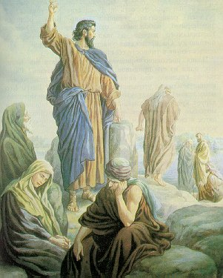
deep insight
fearless commitment
unswerving fidelity to god’s word
person on the margin of society
with a heightened sensitivity to evil
impatience with injustice
shocked and appalled by people’s idolatry and failure to live up to the demands of the covenant

Slide 9
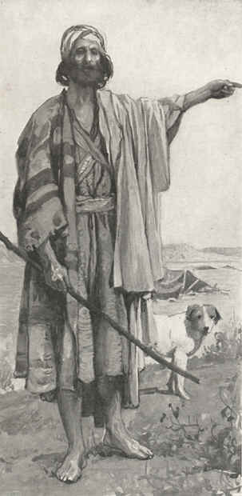
12 Be appalled, O heavens, at this,
be shocked, be utterly desolate,
says the Lord,
13 for my people have committed two evils:
they have forsaken me,
the fountain of living water,
and dug out cisterns for themselves,
cracked cisterns
that can hold no water.
(Jer 2:12-13)
Outraged by the
slightest violation of the
covenant bond

Slide 10
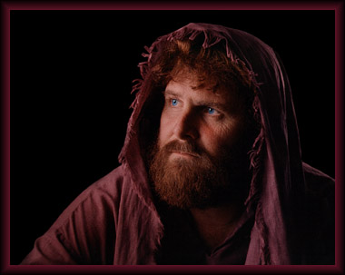
They are:
Custodians of the covenant
Continually called the people back to fidelity to YHWH
Often challenged the King and the bureaucracy – the status quo.

Slide 11
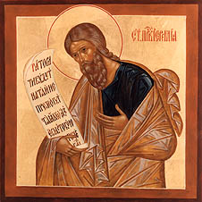
The prophetic mission:
To challenge covenant violators, and
Nurture faith
10 See, today I appoint you over nations and over kingdoms,
to pluck up and to pull down,
to destroy and to overthrow,
to build and to plant.” (Jer 1:10)

Slide 12
Prophets usually speak in:
Judgement formulas;
Parables;
With miracles.
Oracles – often remembered by disciples
Longer speeches – compiled by later editors
Narrative accounts – about the life of the prophet.

Slide 13
2 Samuel 12 - Nathan Confronts David
Then the Lord sent Nathan to David. And he came to him, and said to him: "There were two men in one city, one rich and the other poor. "The rich man had exceedingly many flocks and herds. But the poor man had nothing, except one little ewe lamb which he had bought and nourished; and it grew up together with him and with his children.
Notes:
An example of how the prophet Nathan uses a parable to confront King David about the gravity of what he had done by taking Betsheba.

Slide 14
Cont…2 Samuel 12 - Nathan Confronts David
It ate of his own food and drank from his own cup and lay in his bosom; and it was like a daughter to him. And a traveler came to the rich man, who refused to take from his own flock and from his own herd to prepare one for the wayfaring man who had come to him; but he took the poor man's lamb and prepared it for the man who had come to him."

Slide 15
Early Prophets
Elijah and Elisha – non-writing prophets of the Northern Kingdom
Amos – against social justice and corruption
Hosea – against worship of other gods
Isaiah (first) – encourages kings to trust in God and rule with justice
Micah – criticises corruption and encourages ethical behaviour
All Speak about the Assyrian threat, c. 760-700. Esp in the North (Israel).
Actively criticised those groups who fostered the breaking of the terms of the covenant
Warned of dire punishment for ungodly behaviour

Slide 16
Middle Prophets
Jeremiah - Encourages fidelity to Yahweh reminding the people of God’s love
Ezekiel - Criticises the leaders of Judah and speaks of release from exile
Second Isaiah - Offers a message of hope and release from the exile
All Speak about the Babylonian crisis, c. 600-580. Predominantly from Judah, and use the fallen Northern Israel as an example.

Slide 17
Late Prophets
Haggai
Zechariah - Urge the restoration of the temple and the priesthood
Malachi – Important to get the religion back on track
Obadiah
Joel
Speak about the Persian crisis and how to reestablish their nation. C. 540-480.

Slide 18
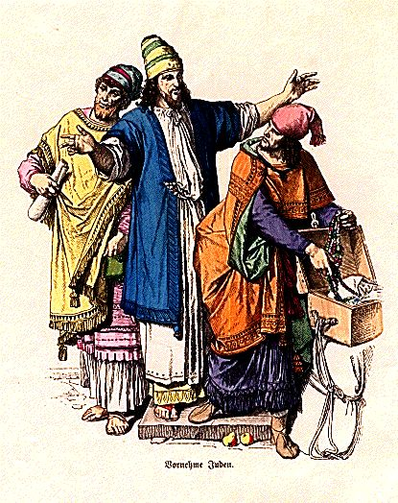
Those in power are
Callous
Unmoved by suffering and injustice
Prophets
Hear the cry of the people
Their speech is often outrageous, desperate and shocking

Slide 19
And I said:
Listen, you heads of Jacob
and rulers of the house of Israel!
Should you not know justice?—
2 you who hate the good and love the evil,
who tear the skin off my people,
and the flesh off their bones;
3 who eat the flesh of my people,
flay their skin off them,
break their bones in pieces,
and chop them up like meat in a kettle,
like flesh in a caldron. (Micah 3:1-3)

Slide 20
The Judgement Oracle…
1. Delivered by the Prophet on behalf of God, the Sender
“Thus says the Lord…”
2. To a Recipient
“Hear, O Israel”
3. History of the relationship between sender and recipient
“I led you out of Egypt."
4. Statement of offence - sin
"You have forgotten me and worshiped other gods."
5. Oracle formula (therefore)
“Therefore, thus says the Lord…”
Punishment.

Slide 21
Foul language
Filthy Language –
Lift up your eyes to the barren heights and see
Where have you not been f….d? Jer 3:2
Pornographic Imagery –
And she (Jerusalem) lusted after her lovers (Assyrians and Babylonians) there, whose members were like those of donkeys, and whose emission was like that of stallions. Ezek 23:20
Images that disgust –
I am like a moth to Ephraim
And like the rottenness of maggots to Judah. Hos 5:12

Slide 22
These Prophets…
Use language, personality and arresting behaviour to:
Shock the people out of their comfort zone
Expose the evils and dangers of their values
Strive to bring about a change of attitude

Slide 23
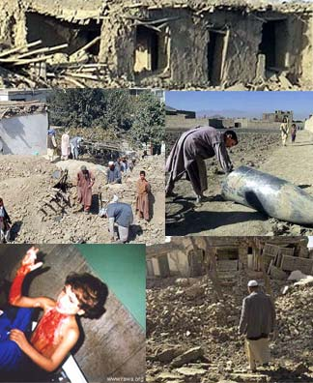
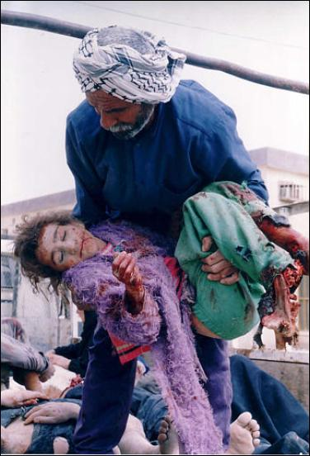
The prophets used grotesque imagery to speak of contemporary horrors…
This is Afghanistan…

Slide 24
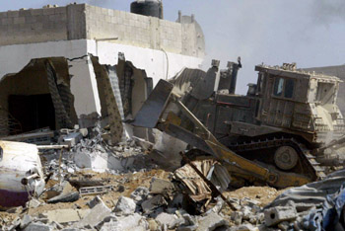
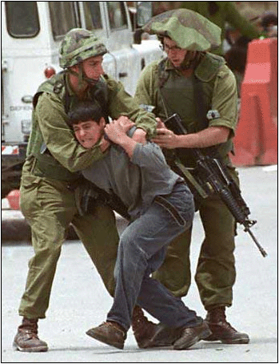
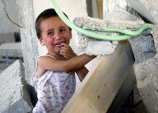
Palestine…

Slide 25
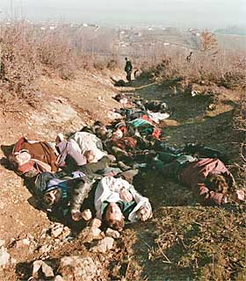
Kosovo (ethnic cleansing)…

Slide 26
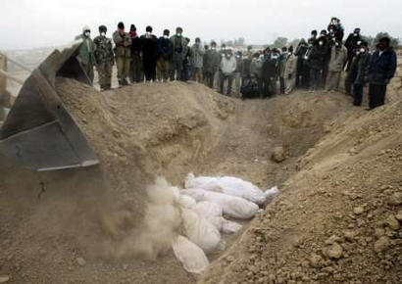
Iraq…

Slide 27
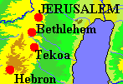
The Prophets spoke out strongly against
INJUSTICE - where the rich took advantage of the poor
VIOLENCE - where the powerless were ill treated by the powerful
For example, Amos:
A herdsman from Tekoa who Felt the call to do something about gross injustice in the northern kingdom of Israel.

Slide 28
As a traveller to the North, Amos saw:
The rich charging unreasonable rent for housing and land – ensuring the poor were kept poor
The rich living in extravagant luxury - while the poor struggled for survival
So he:
Criticised the king and his administration for not considering the disadvantaged
Accused the upper classes for not living according to the terms of the covenant
Warned that there would be punishment for the social injustice in the land

Slide 29
Amos is despised for his message by those he criticised
He is rebuked by the chief priest Amaziah Amos answers that he is doing God’s work – not his own
¹⁴ Then Amos answered Amaziah, “I am no prophet, nor a prophet’s son; but I am a herdsman, and a dresser of sycamore trees, ¹⁵ and the LORD took me from following the flock, and the LORD said to me, ‘Go, prophesy to my people Israel.’ (Amos 7:14-15)
He cannot resist the call to do something about the injustice he sees

Slide 30
Prophets
did not spare the religious establishment of their day
Priests and court prophets had abandoned covenant responsibility and subordinated justice to practices of empty religion
¹³ For from the least to the greatest of them,
everyone is greedy for unjust gain;
and from prophet to priest,
everyone deals falsely.
¹⁴ They have treated the wound of my people carelessly,
saying, “Peace, peace,”
when there is no peace. (Jer 6:13-14)

Slide 31
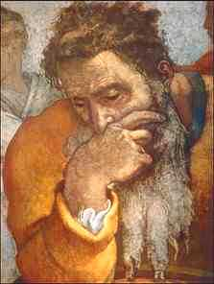
These power figures react against the prophet and retaliate.
Prophets are often very lonely, persecuted, ridiculed and are racked by self-doubt.
They often mistrust their own clarity and vision.

