Slide 1
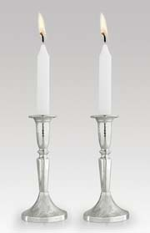
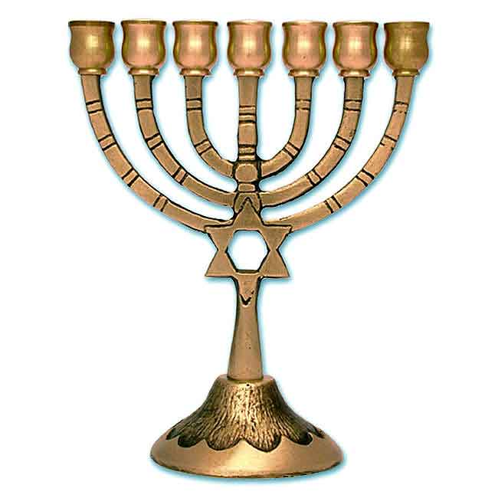
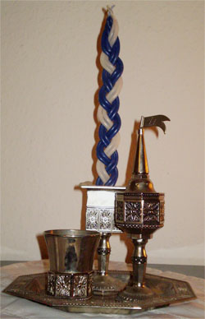
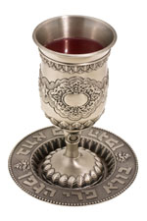
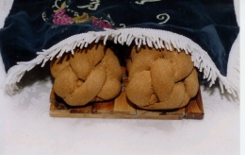
The Jewish Sabbath
Syllabus (learn to) statement: Describe the importance of Shabbat

Slide 2
A visual introduction to the Sabbath
Explanation of Shabbat - http://www.youtube.com/watch?v=rtuTJ1mAyuk
Cartoon Shabbat - http://www.youtube.com/watch?NR=1&v=zKcYRCbsGfQ

Slide 3
What happened in Genesis to inspire the Sabbath observance?
Genesis 2:1-3
Thus the heavens and the earth were completed in all their vast array. By the seventh day God had finished the work he had been doing; so on the seventh day he rested from all his work. ³ Then God blessed the seventh day and made it holy, because on it he rested from all the work of creating that he had done.

Slide 4
Primary Function of Sabbath
Shamor: to keep or observe
Zakor: to remember
Remembrance of creation
Building an atmosphere of nourishing the faith
Lessons flow onto the rest of the week
Commonality with God
Spiritual nourishment
Building community
No control of time and work: a reminder of slavery in Egypt and freedom from this (continual ties with the Exodus)

Slide 5
Examine extracts from the Hebrew Scriptures which demonstrate the principal beliefs (observance of the Sabbath) of Judaism
Exodus 20:8 “Remember the Sabbath day by keeping it holy.”
Exodus 20:10 “but the seventh day is a sabbath to the LORD your God. On it you shall not do any work, neither you, nor your son or daughter, nor your male or female servant, nor your animals, nor any foreigner residing in your towns.”
Exodus 16:23 “He said to them, “This is what the LORD commanded: ‘Tomorrow is to be a day of sabbath rest, a holy sabbath to the LORD. So bake what you want to bake and boil what you want to boil. Save whatever is left and keep it until morning.”
Exodus 16:26 “Six days you are to gather it, but on the seventh day, the Sabbath, there will not be any.”
Exodus 31:13 “Say to the Israelites, ‘You must observe my Sabbaths. This will be a sign between me and you for the generations to come, so you may know that I am the LORD, who makes you holy.”

Slide 6
A day without work
Growing and preparing food (11 prohibitions)
Making clothing (13 prohibitions)
Leatherwork and writing (9 prohibitions)
Providing shelter (2 prohibitions)
Creating and extinguishing fire (2 prohibitions)
Completing work ( 1 prohibitions)
Transporting goods (1 prohibitions)

Slide 7
Foods for the Sabbath
Challah: means ‘dough’, in particular the separated portion of dough from each batch of bread.
A piece of challah for the ritual burning can be removed after baking if it has not been done prior. A special blessing is recited upon this separation: “Blessed are You, Lord our God, King of the Universe, who has sanctified us with His commandments and commanded us to separate.”
On Friday Night two challot (the plural of challah) are present on the dinner table. This commemorates the double portion of manna that was received from God on Fridays by the people of Israel in the desert. This provided the people in the desert with manna for Shabbat. Some people sprinkle sesame or poppy seeds over the challah before baking to further symbolise this manna.
A blessing is recited before the breaking and eating of the bread. It is common practice to refrain from cutting the bread with a knife, which is likened to the weapons of war used to profane the altar, as decreed in Exodus 20:22. This custom also signifies Isaiah’s prophecy in Isaiah 2:4: “And they shall beat their swords into plowshares…” Thus the challah is broken up and divided by hand.

Slide 8
Foods for the Sabbath
Challah is traditionally covered by a challah cloth prior to the saying of the blessing over the bread. Here the challah cloth is partially removed to allow the two challahs underneath to be seen. Note that they rest on a special, decorative challah (bread) board.
After the bread has been blessed it should be salted, in recognition of the rituals of the Temple sacrifices, and a reflection of Genesis 3:19: “By the sweat of your brow shall you get bread to eat”.
It is customary to leave the broken bread on a communal plate, or for a piece to be put on every individual plate instead of handing it to people, to stress that we do not receive our bread from man. This further reminds us of God’s presence and provision.
Before the challah is blessed, and during the blessing for the wine, the bread is kept covered by a cloth. This is to shield its ‘sensitive feelings’, teaching us that we must respect inanimate objects as well as those that live.
http://bje.org.au/learning/judaism/holydays/shabbat/symbols_foods.html

Slide 9
Foods for the Sabbath
Wine: is regarded as particularly sacred and has its own bracha (blessing). Wine sanctifies the Sabbath at its inception (kiddush) and its conclusion (havdalah). The English word 'wine' may derive from the Hebrew yayin.
The kiddush cup: although it isn’t eaten, is a special goblet set aside for the blessing of the wine. If possible, it should be made from silver. The kiddush wine should lull you into a state of Shabbat serenity. It symbolises joy and cheer, and therefore it is fitting to declare the sanctity of the Sabbath over the cup of wine.
http://bje.org.au/learning/judaism/holydays/shabbat/symbols_foods.html

Slide 10
Foods for the Passover
Matzah: Unleavened bread similar to a cracker and symbolises the haste with which the Hebrews experienced when they were fleeing slavery in Egypt.
Haroseth: (A mixture of crushed nuts, apples, cinnamon, and honey, which symbolizes the mortar the Hebrew slaves in Egypt used in constructing buildings for the Pharaoh.
Beitzah: (Roasted Hard Boiled Egg) used to symbolise the first Passover sacrifice of the lamb. The egg also symbolizes mourning for the destruction of the second Temple by the Romans in 70 C.E.
Salt Water: The Passover Seder meal is begun by dipping a hard-boiled roasted egg into salt water which symbolizes both the tears of oppression as well as of joy in freedom
Maror: This is very bitter horse-radish that symbolizes the hardships of slavery.
Karpas: This is a mixture of boiled potatoes or radishes, and parsley which is dipped in salt water and symbolises the undernourishment of the Hebrew slaves, as well as the new Spring season.
Z'roah: This piece of meat, sometimes represented as a lamb shankbone, is not eaten but instead serves as a reminder and symbolises the Paschal lamb and its sacrifice by the Hebrews. It also refers to God's rescuing of the Hebrews from Egyptian slavery.

Slide 11
Symbols of the Sabbath
Candlesticks
The candle is very significant in Jewish life. Fire is one of the basic elements of the world. It is frightening, as well as warm and inviting. In the Kabbalah (Jewish mysticism), the flame is said to symbolise God’s relation to the world and man.
Candles are lit on the Friday night leading into Shabbat (Sabbath) as part of Shalom Bayit (harmony in the home), and Oneg Shabbat (Sabbath joy). God “sanctified us by His commandments and commanded us to kindle the Sabbath light.” The candles should be in the room where the Friday night meal is eaten.
At least two candles must be lit, to signify shamor (observance) and zachor (remembrance). The pair also symbolise the duality of all being: man and woman, body and soul, speech and silence, creation and revelation.
http://bje.org.au/learning/judaism/holydays/shabbat/symbols_foods.html

Slide 12
Symbols of the Sabbath
Havdalah set
Havdalah is the short ceremony that farewells the Shabbat and ushers in a new week. A special twisted multi-wick candle is lit, or, failing this, two lit candles may be used and their flames put together. This reminds us of a midrash (rabbinic tradition) that G-d showed Adam and Eve how to make fire at the conclusion of the first Sabbath and shortly before they were expelled from the Garden of Eden. Many people have the custom of using a candle with six braids which represent the six secular days of the week which culminate in the spiritual highlight of Shabbat. As we look at the havdalah candle, we look at our fingers to make use of the light, and thus not render the benediction over the light in vain.
The sweet smelling spices used for Havdalah symbolise a spiritual feast for the extra soul (neshama yetairah) which leaves our bodies at the conclusion of Shabbat. The spices are a last taste of paradise.
http://bje.org.au/learning/judaism/holydays/shabbat/symbols_foods.html

Slide 13
Prayer on the Sabbath
Blessing over Candles
Barukh atah Adonai, Eloheinu, melekh ha'olam Blessed are you, Lord, our God, sovereign of the universe asher kidishanu b'mitz'votav v'tzivanu Who has sanctified us with His commandments and commanded us l'had'lik neir shel Shabbat. (Amein) to light the lights of Shabbat. (Amen)
http://www.jewfaq.org/prayer/shabbat.htm

Slide 14
Prayer on the Sabbath
Kiddush
Kiddush is recited while holding a cup of wine or other liquid, no less than 3.3 ounces
Vay'hi erev vay'hi voker yom hashishi And there was evening and there was morning, a sixth day vay'khulu hashamayim v'ha'aretz v'khol tz'va'am The heavens and the earth were finished, the whole host of them vay'khal elohim bayom hash'vi'i m'la'kh'to asher asah And on the seventh day God completed his work that he had done vayish'bot bayom hash'vi'i mikol m'la'kh'to asher asah and he rested on the seventh day from all his work that he had done Vay'varekh Elohim et yom hash'vi'i vay'kadeish oto And God blessed the seventh day, and sanctified it ki vo shavat mikol m'la'kh'to asher bara Elohim la'asot because in it he had rested from all his work that God had created to do Barukh atah Adonai, Eloheinu, melekh ha-olam Blessed are you, Lord, our God, sovereign of the universe (if using wine or grape juice) borei p'ri hagafen (Amein) Who creates the fruit of the vine (Amen)
http://www.jewfaq.org/prayer/shabbat.htm

Slide 15
Prayer on the Sabbath
Washing Hands
After Kiddush and before the meal, each person in the household should wash hands by filling a cup with water and pouring it over the top and bottom of the right hand and then the left hand. Before wiping the hands dry on a towel, the following blessing should be recited.
Barukh atah Adonai, Eloheinu, melekh ha-olam Blessed are You, Lord, our God, King of the Universe asher kidishanu b'mitz'votav v'tzivanu Who has sanctified us with His commandments and commanded us al n'tilat yadayim. concerning washing of hands.
Why is there no "Amen" at the end of this blessing? Traditionally, each person washes their own hands, and each person says their own blessing. You don't say "Amen" to your own blessing, and everybody says their own n'tilat yadayim, so there is no "Amen"! With the other blessings on this page, a leader says the blessing on behalf of everyone, and the others say "Amen.“
http://www.jewfaq.org/prayer/shabbat.htm

Slide 16
Prayer on the Sabbath
Ha-Motzi
Immediately after washing hands and before eating, the head of the household should remove the cover from the two challah loaves, lifting them while reciting the following blessing. The challah is then ripped into pieces or sliced and passed around the table, so that each person may have a piece. The family meal may then begin.
Barukh atah Adonai, Eloheinu, melekh ha-olam Blessed are You, Lord, our God, King of the Universe hamotzi lechem min ha'aretz. (Amein). who brings forth bread from the earth. (Amen)
http://www.jewfaq.org/prayer/shabbat.htm

Slide 17
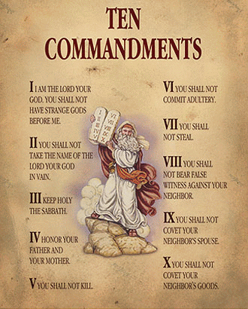
Syllabus Questions: How can we synthesise the (1) importance of the covenant and the (2) importance of the Shabbat for the Jewish people?
Consider that the establishment of the covenant between the Israelites and God occurred at Mt Sinai with the Ten Commandments and the Sabbath is the third commandment.
What is the meaning of covenant for the Jews?
Why is it important for the Jewish people to maintain their observance of the Shabbat?
Fidelity to God.
Living the covenant initiated by Moses

Slide 18
Extra Youtube Clips
Rabbi explains Shabbat - http://www.youtube.com/watch?v=m78dTwKCg8k
College Shabbat experience - http://www.youtube.com/watch?v=AY4YDWmxsPE
Explanation of Shabbat - http://www.youtube.com/watch?v=btpQvVbNcpw
Good Shabbos song - http://www.youtube.com/watch?v=K7maoNGTL2w

Slide 19
USEFUL WEBSITES
NSW Jewish Board of Deputies Website
http://www.nswjbd.org/Judaism/default.aspx
My Jewish Learning
www.myjewishlearning.com
Judaism 101
http://www.jewfaq.org/index.htm

