Slide 1
Sacred Books of Judaism
TORAH
Genesis
Exodus
(The Instruction or Guide for Living)
Leviticus
Numbers
PENTATEUCH CHUMASH
Deuteronomy
TORAH – the first 5 books
NEVIIM – the Prophets
KETUVIM – the Writings
TANAKH
Bible
Notes:
Tanakh - dots included by the Masorites well after Christ to identify vowels within the text.
Neviim – Ne-ve-eem
Ketuvim – Ket-u-vi-um

Slide 2
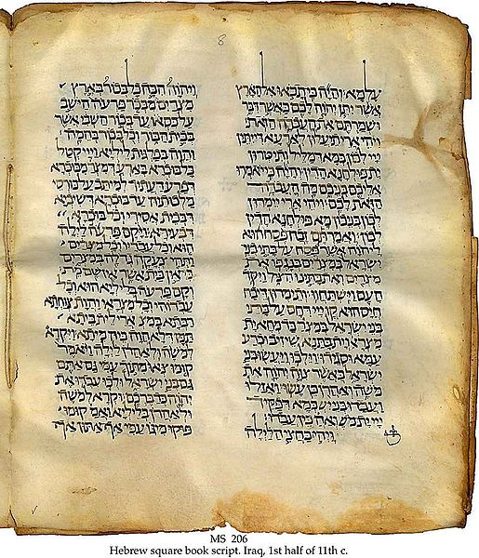
Aramaic translation of the Hebrew Bible (Tanakh) compiled from the Second Temple period until the early Middle Ages
TARGUM
Targumim emerged from Babylonia and Israel to meet the needs of ordinary folk whose daily language was Aramaic
11th century page of Targum
Notes:
Judaism is a fluid, living, dynamic religion which does not end with the text. Orthodoxy is strictly adherent to the Law whilst still leaving the Tanakh open for continual reflection and interpretation.

Slide 3
Mikraot Gedolot (The Great Scriptures)

Masoretic Text - with vocalization & cantillation marks
MT copied & edited by scribes/scholars in the Muslim world (esp. Tiberius, Jerusalem & Babylonia) between 7th -11th centuries
Edition of
Tanakh
that includes

TARGUM
Onkelos & Jonathan
(Pseudo-Jonathan for Torah)
Rashi (Rabbi Shlomo Yitzhaki)
Rashbam (Rab Shmuel ben Meir)
Abraham Ibn Ezra
David Kimhi (Radak)
Nahmanides (Moshe ben Nahman)
Obadiah ben Jacob Sforno
Shabbethai Bass (Siftei Chakhamim)
Rabbinic Commentaries

Notes:
Rashi – scholar (most texts come with commentaries on writings). Sometimes English accompaniments do not allow space.

Slide 4
Masoretic Text
Cantillation marks
וְהַנָּחָשׁ֙ הָיָ֣ה עָר֔וּם מִכֹּל֙ חַיַּ֣ת הַשָּׂדֶ֔ה אֲשֶׁ֥ר
עָשָׂ֖ה יְהוָ֣ה אֱלֹהִ֑ים וַיֹּ֙אמֶר֙ אֶל־הָ֣אִשָּׁ֔ה אַ֚ף
Gen 3:1
Vowel points
Notes:
Cantillation marks assist singing (e.g. breath points and accentuations).

Slide 5
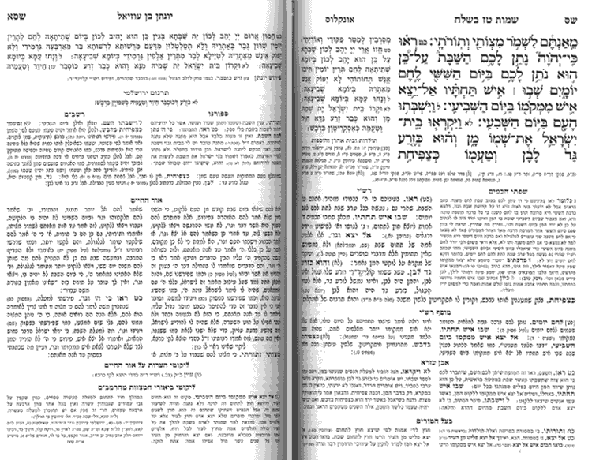
Page of Mikraot Gedolot
Targum Onkelos
Bible text
Targum Yonatan
Ex 16:28
Rashi
Ibn Ezra
Notes:
The original intention of the Tanakh is metaphorical and so is not considered definitive.
700-500 BCE – The Tanakh was written during the Babylonian Exile and completed during 70 BCE where Talmud was beginning to be written.

Slide 6
TALMUD
Instruction / learning
Written version of Oral Law
Mishnah
Debates of Rabbis (Tannaim) with focus on case- based laws of the period 70-200 a.d.
TALMUD
Gemara
Commentaries on the written Mishnah by post-200 a.d. Rabbis (Amoraim)

Slide 7
Babylonian Talmud (Talmud Bavli)
compiled by Jewish scholars in Babylon in 5th century a.d.
2 TALMUDIM
Rabbinic commentaries added in Middle Ages
Jerusalem Talmud (Talmud Yerushalmi)
produced around 350 a.d. by rabbis in academies of
Tiberias and Caesarea
Contains more comprehensive collection of rabbinic opinions
Babylonian Talmud
Superior editing makes it more accessible and readily usable
Modern Jewish practice gives preference to Bavli

Slide 8
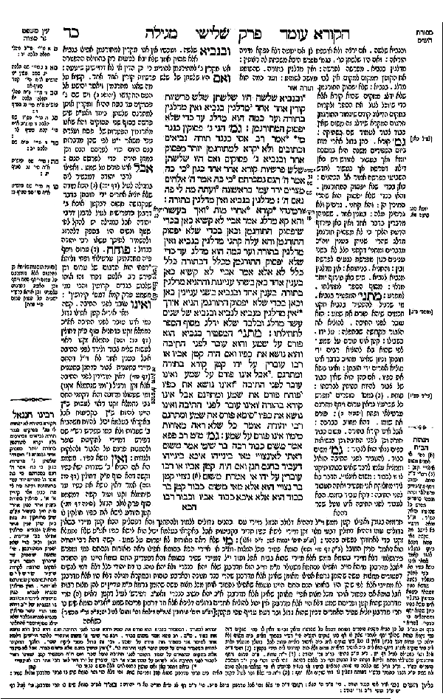
Page of Talmud
Mishnah
Gemara
Rashi’s Commentary
(1040-1105)
Gemara comment follows Mishnah passage and the sequence is repeated in the centre column
Tosafot
Supplementary commentaries of major rabbis from 11th – 13th centuries
Additional commentaries

Slide 9
סוף

